Slide 2
Stochastic 3D redox and geological models for nitrate contamination assessment
By Rasmus Bødker Madsen, Postdoc

Slide 3
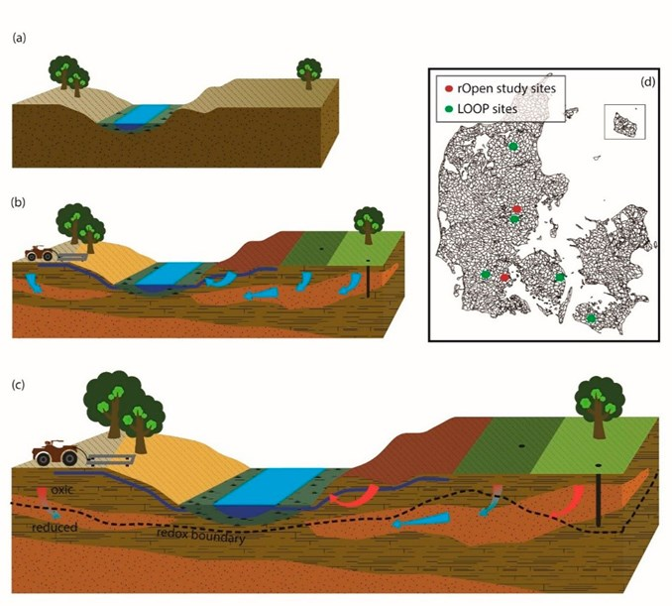
Motivation
Title: Stochastic 3D redox and geological models for nitrate contamination assessment
Title: Stochastic 3D redox and geological models for nitrate contamination assessment
Research conducted as part of Innovation Fund Denmark project “Mapfield”
  One aim is development of techniques and concept for targeted N-regulation in Danish agriculture to protect groundwater and surface water resources
Nitrate contamination from surface:
  Redox conditions: Determine phases and concentrations of nitrate
  Geological architecture: Govern flow and transport of nitrate
Detailed mapping of redox and geology in 3D
Make multiple possible solution of subsurface architechture
  Asses nitrate vulnerability
Title: Stochastic 3D redox and geological models for nitrate contamination assessment
Title: Stochastic 3D redox and geological models for nitrate contamination assessment

Slide 4
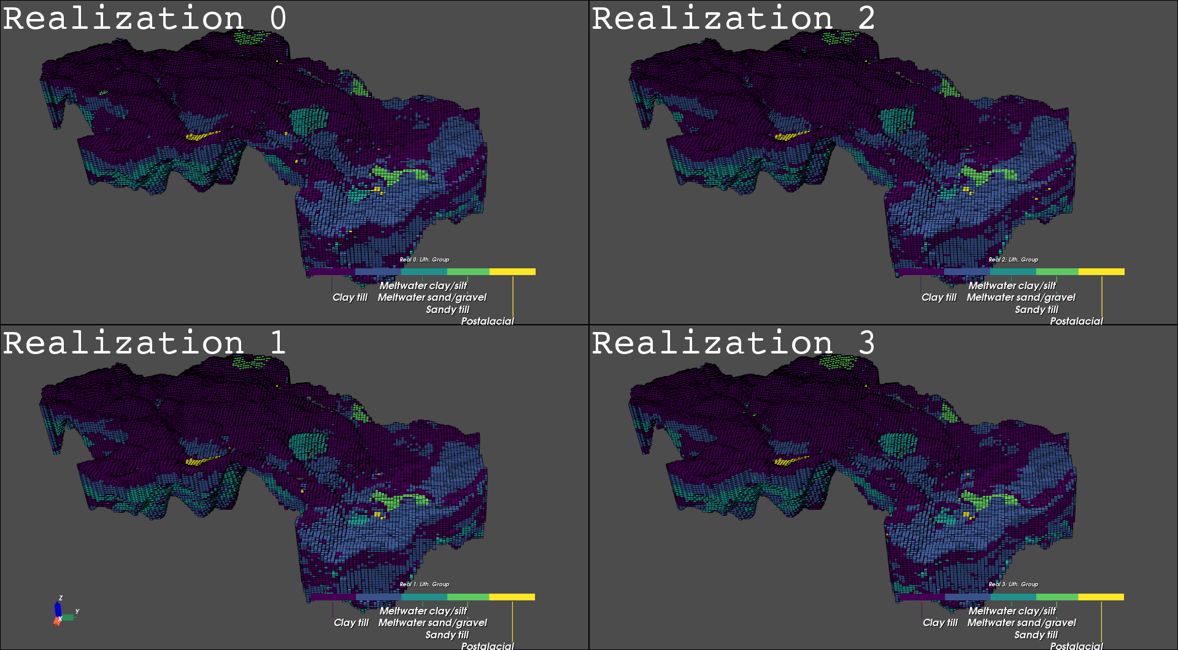
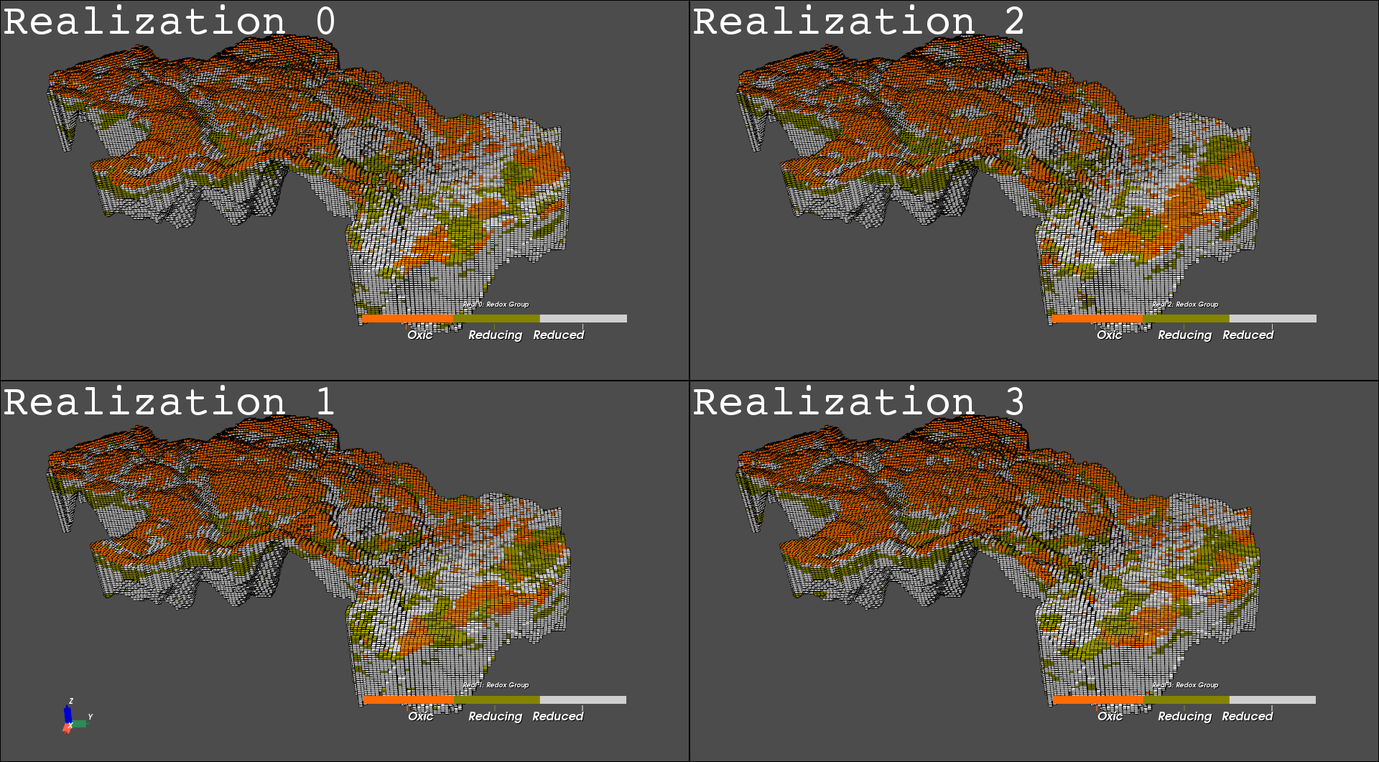
Results from LOOP 3
GEOLOGY
REDOX

Slide 5
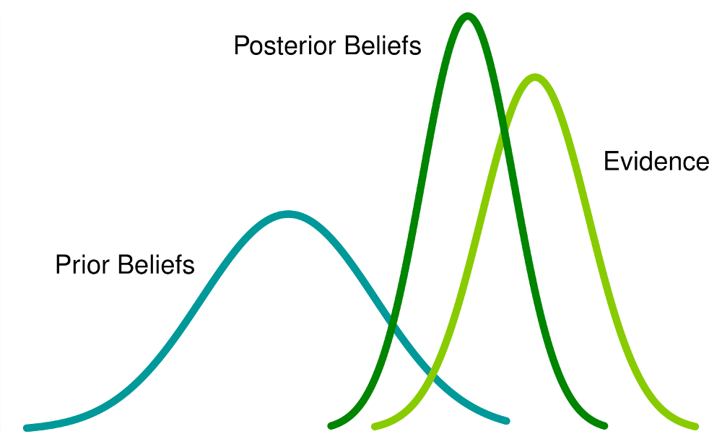

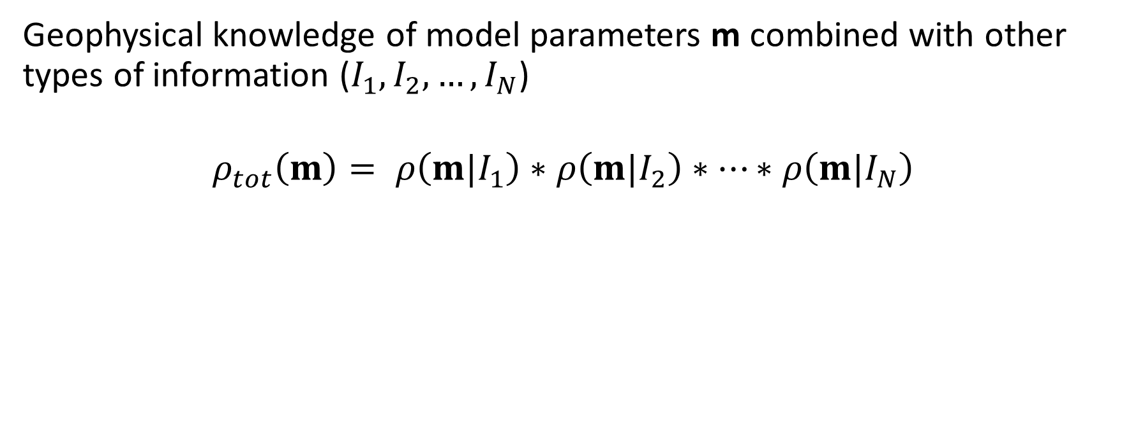



Probabilistic data integration
Geophysical knowledge of model parameters m combined with other types of information ($I_{1},I_{2},…,I_{N}$)
$$ρ_{tot}\left(m\right)= ρ\left(m|I_{1}\right)∗ρ\left(m|I_{2}\right)∗…∗ρ\left(m|I_{N}\right)$$
$$ρ_{tot}\left(m\right)$$
Geologic knowledge
(direct information)
Boreholes
(direct information)
Geophysics
(indirect information)
$$ρ\left(m|I_{1}\right)$$
$$ρ\left(m|I_{2}\right)$$
$$ρ\left(m|I_{1}\right)$$
  $$\text{MPS}\text{: }\text{Multiple}\text{−}\text{point} \text{geostatistics}\text{ (}\text{Direct} \text{sampling}\text{)}$$

Slide 6
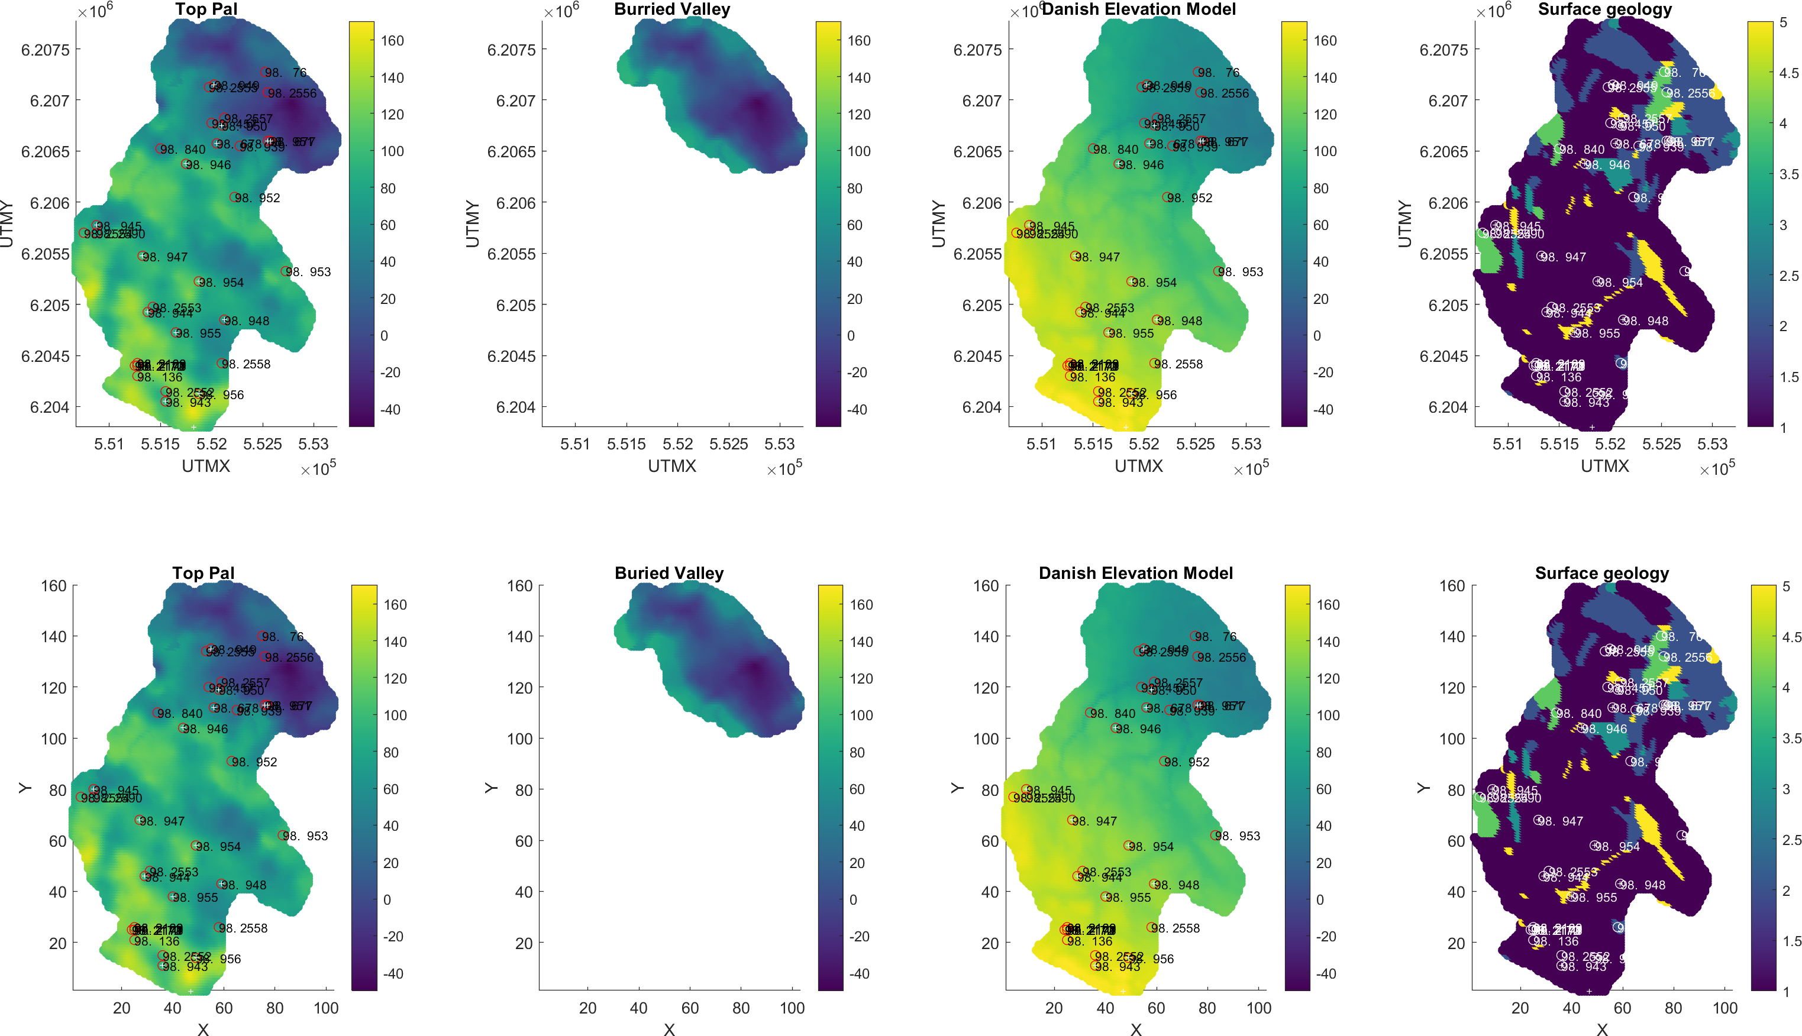
Available data – LOOP 3
LOOP 3 - Ejer Bavnehøj
Data avilable:
  tTEM (moderate/low coverage)
  Boreholes (geochemistry + lithology)
  Additional boreholes (lithological) from JUPITER database + sediment color
    Sediment color used as proxy for redox
  Digital elevation models
  Soil maps

Slide 7
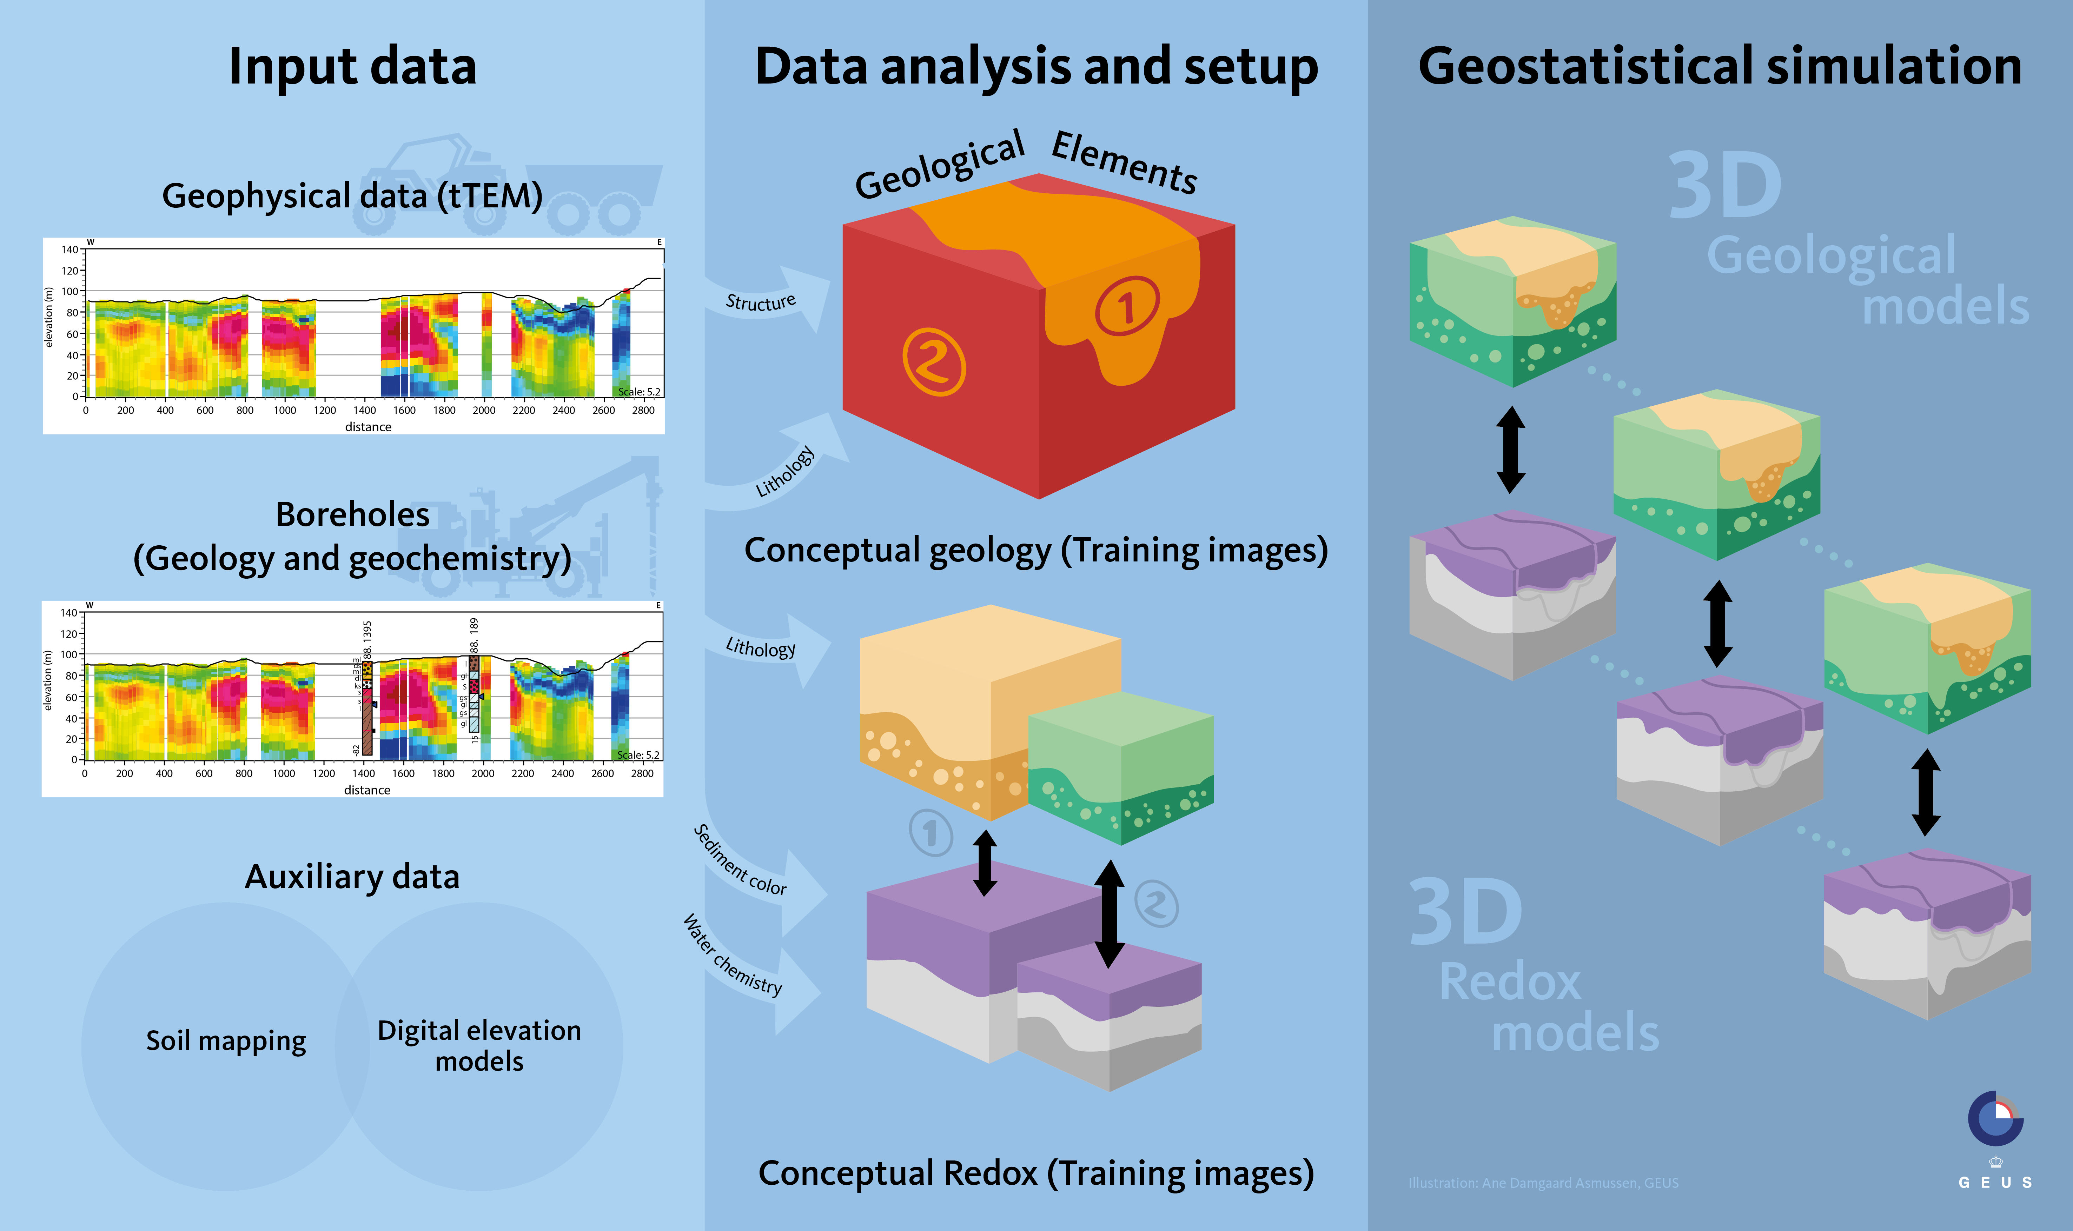
Schematic modelling framework
Geophysics
(indirect information)
Boreholes
(direct information)

Slide 8
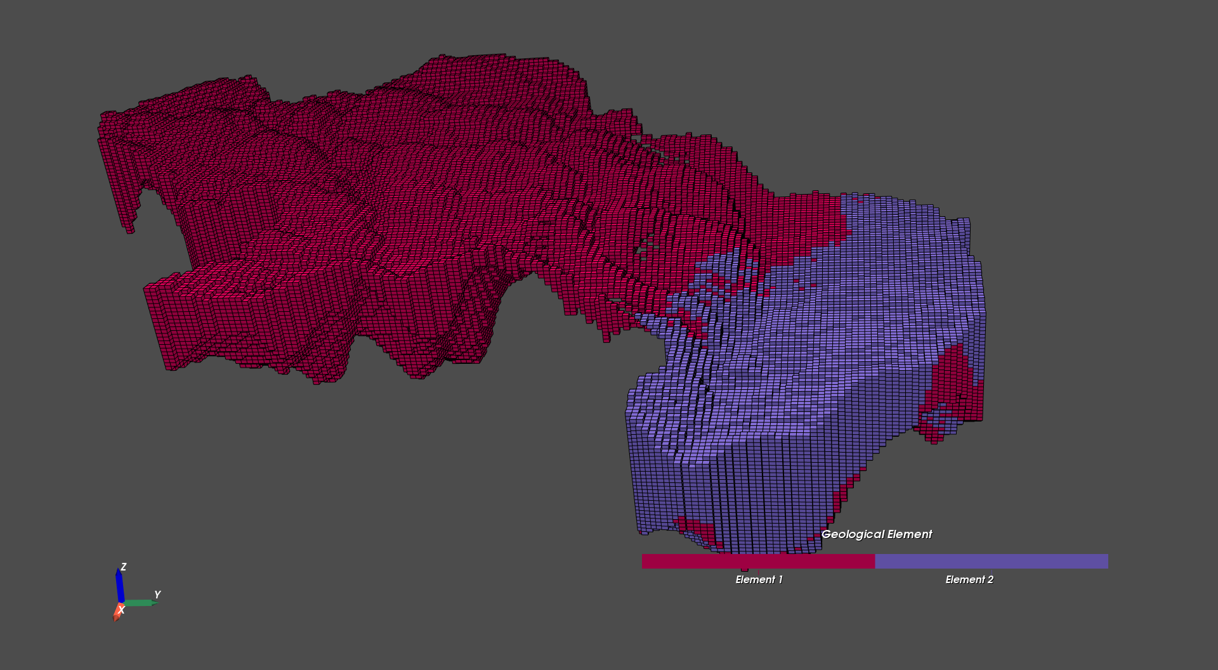
LOOP 3 - Geological elements
Paleogene clay interpreted and used as lower boundary
Element 1 (red): Quarternary-sequence sediments
Element 2 (purple): Buried valley

Slide 9
Schematic modelling framework
Geophysics
(indirect information)
Boreholes
(direct information)

Slide 10
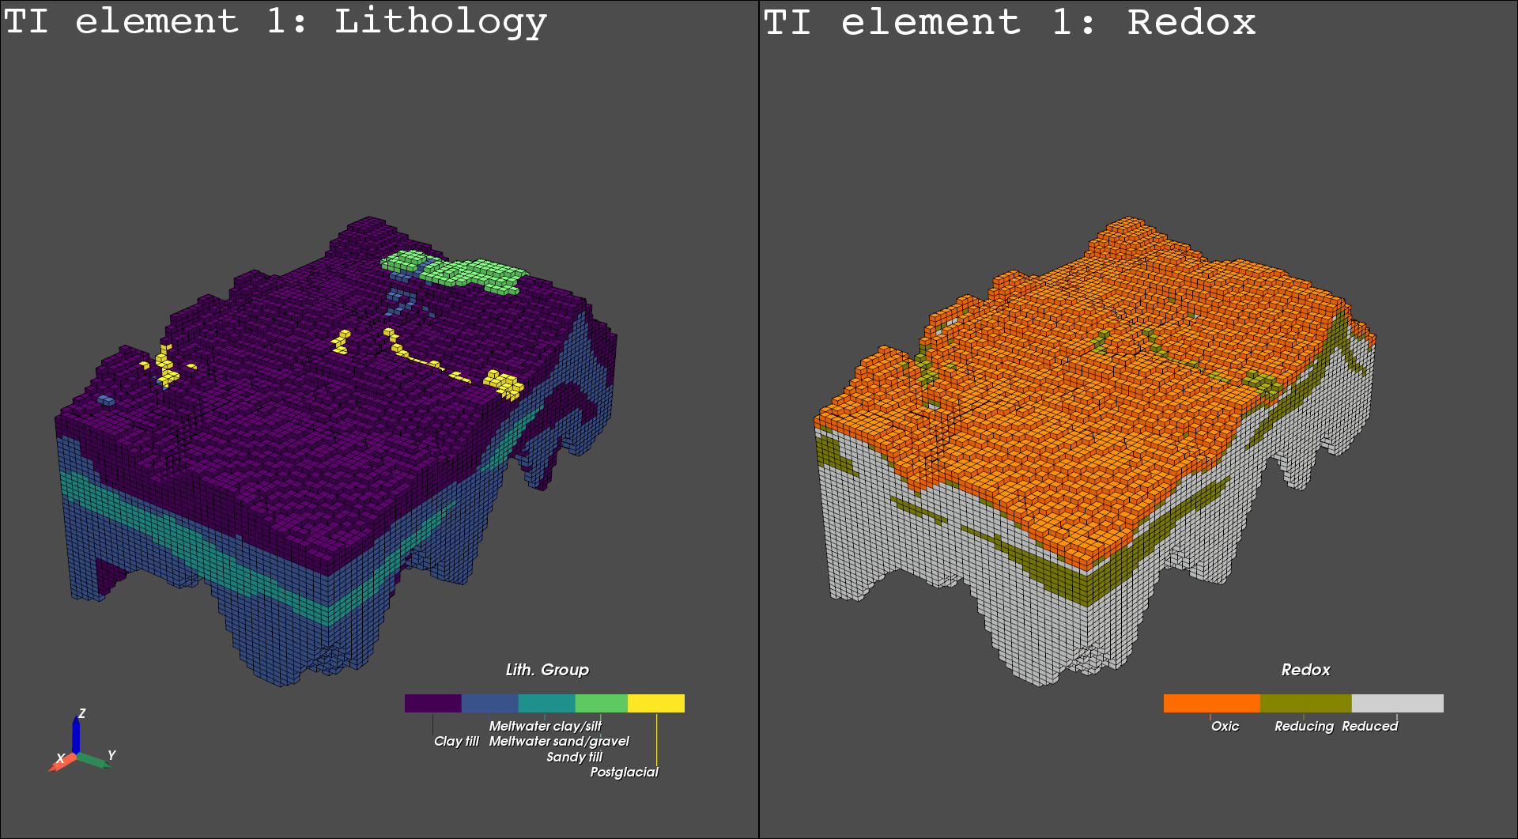
Training images (Quaternary sequence)
Geology (Produced from tTEM and boreholes)
Redox (From geology TI and boreholes)

Slide 11
Schematic modelling framework
Geophysics
(indirect information)
Boreholes
(direct information)

Slide 12
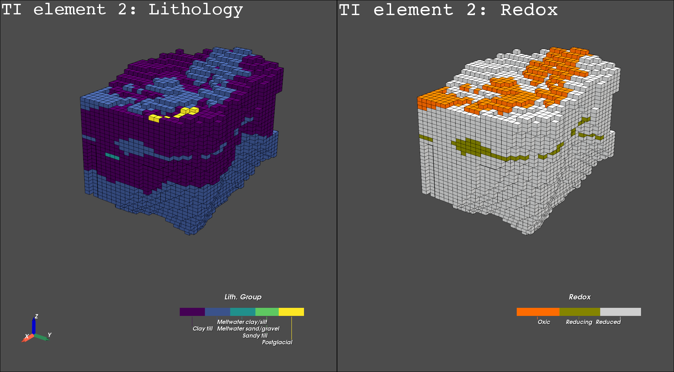
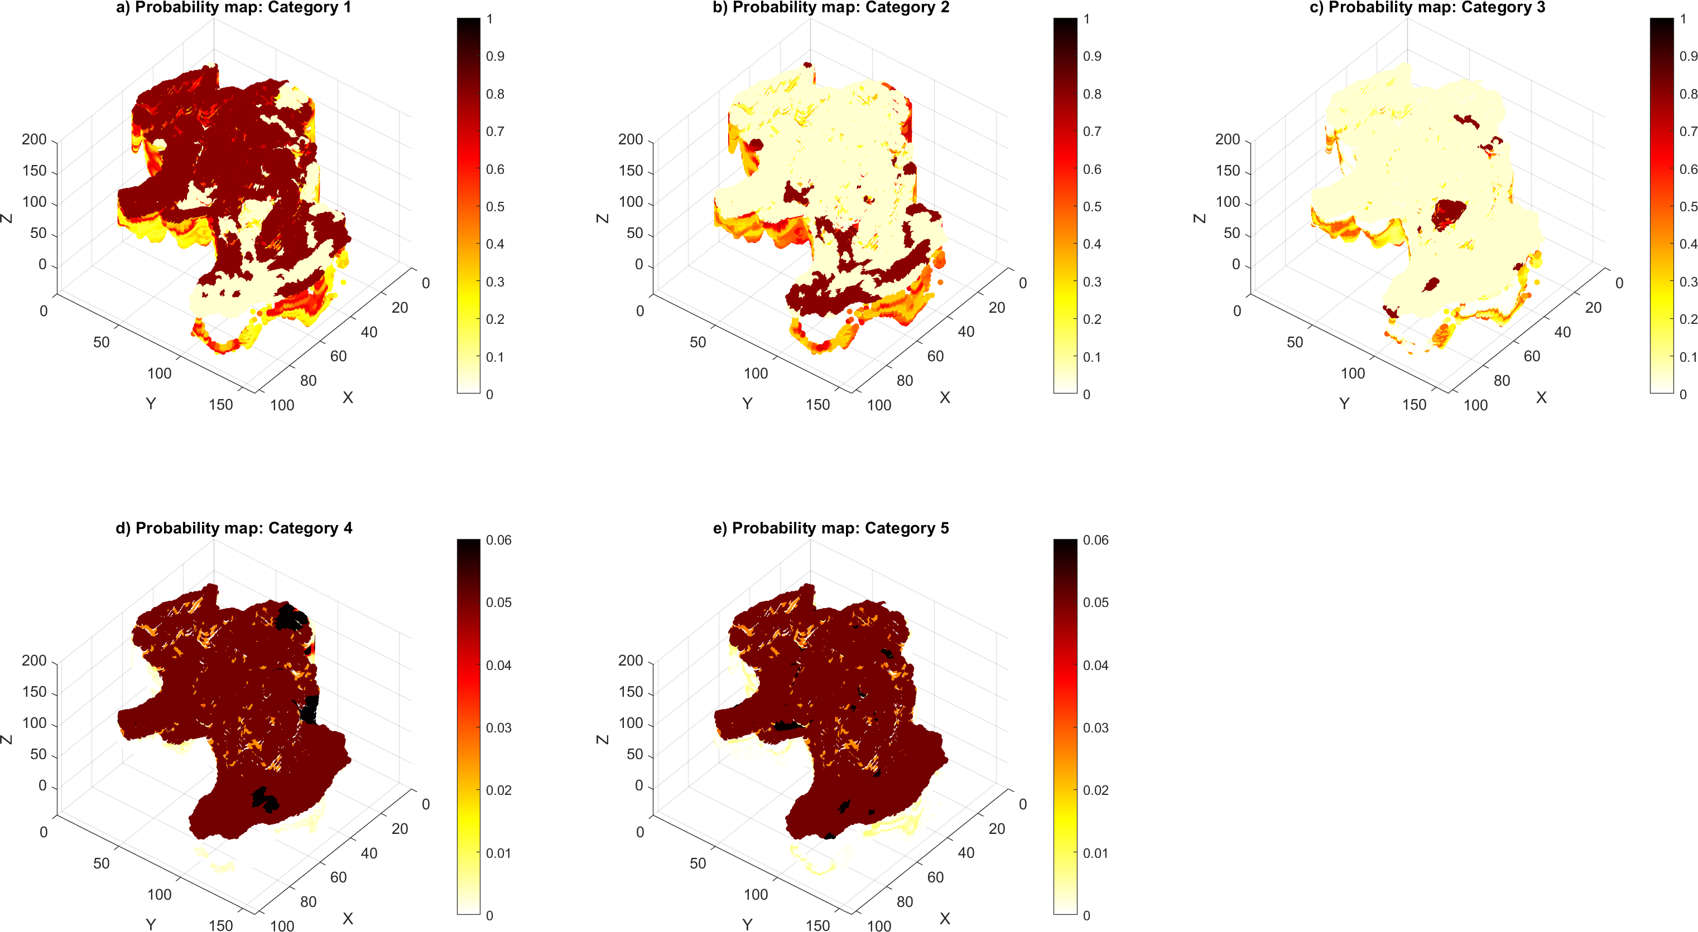
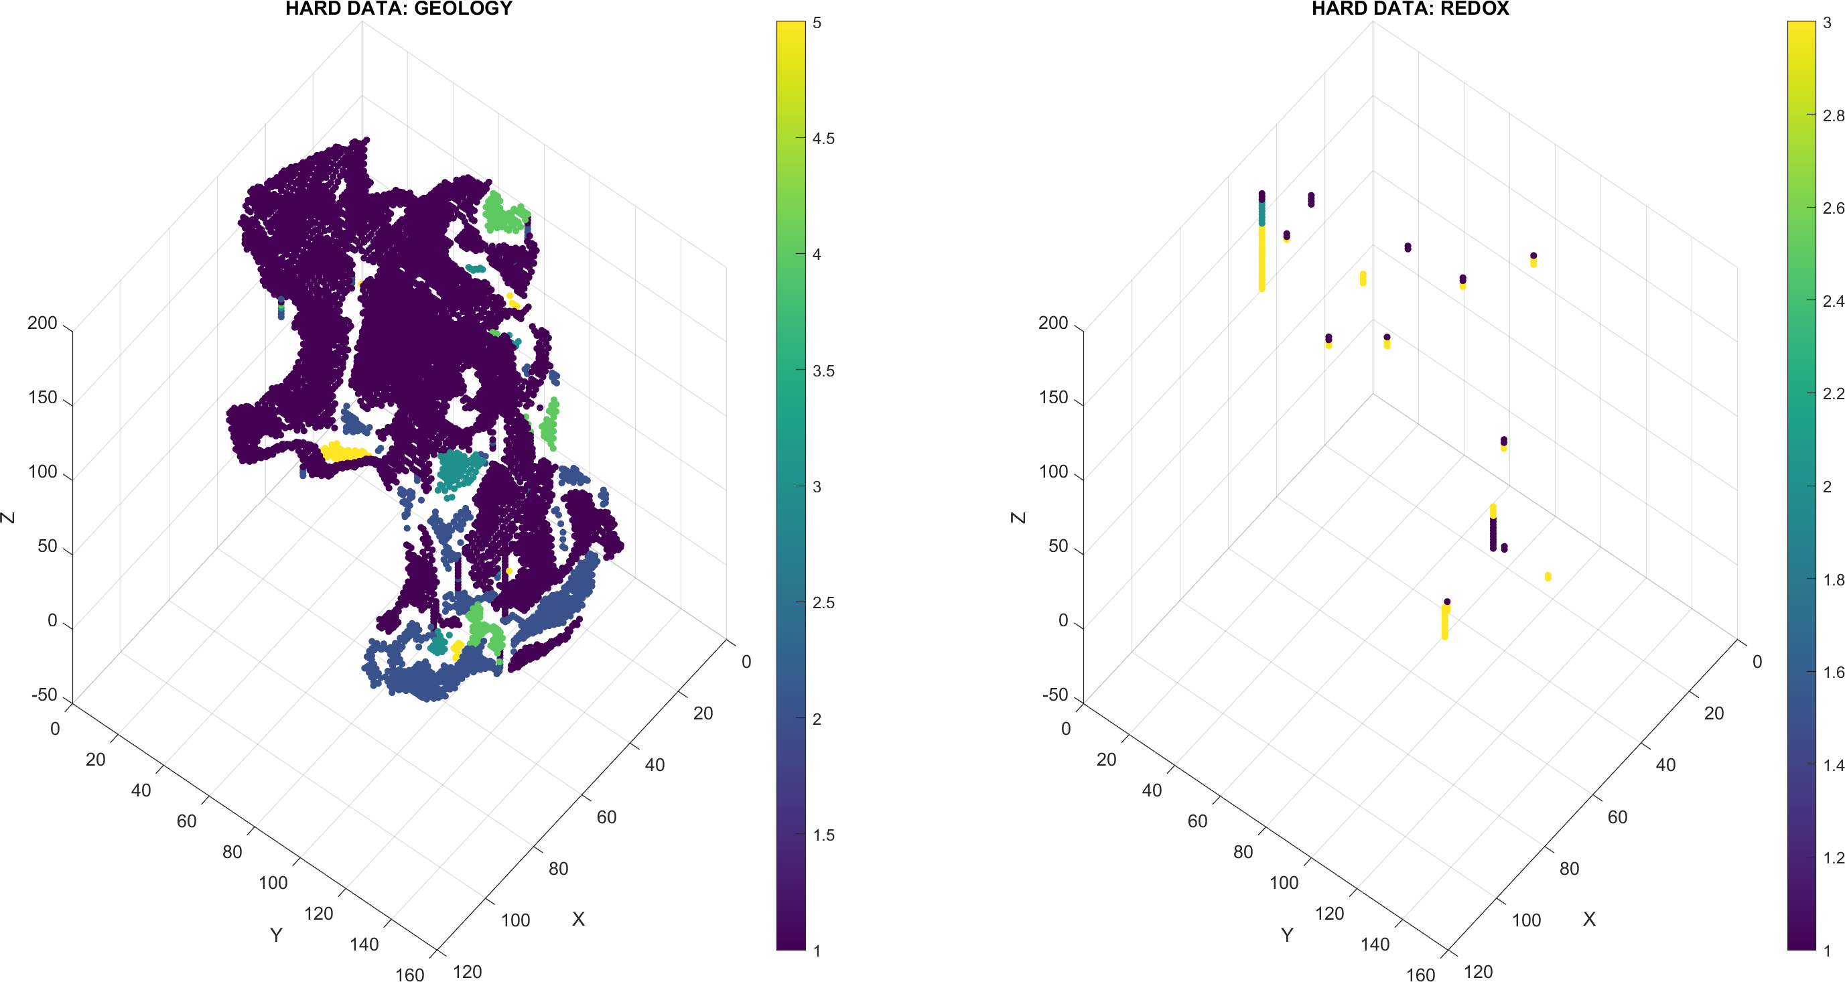
Geostatistical simulation
  Simulation grid 25m x 25m x 2m (Based on geological elements)
  Training images
  Conditioning data (Surface geology, boreholes, tTEM)
    Hard data: Placed directly in simulation grid
    Soft data: Prior probabilities on geology and redox

Slide 13
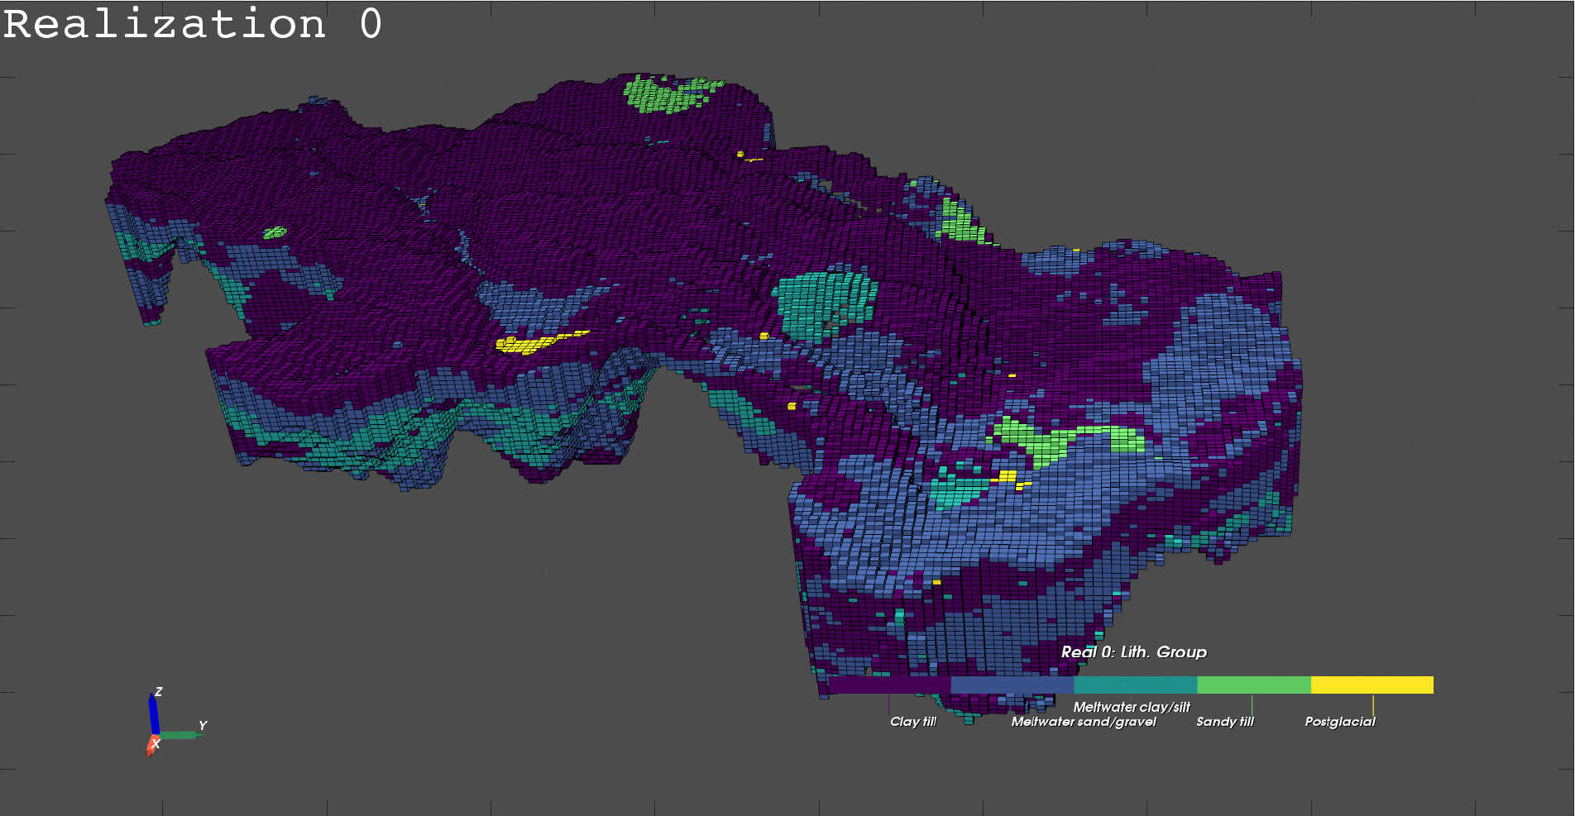
Posterior realizations - Geology

Slide 14
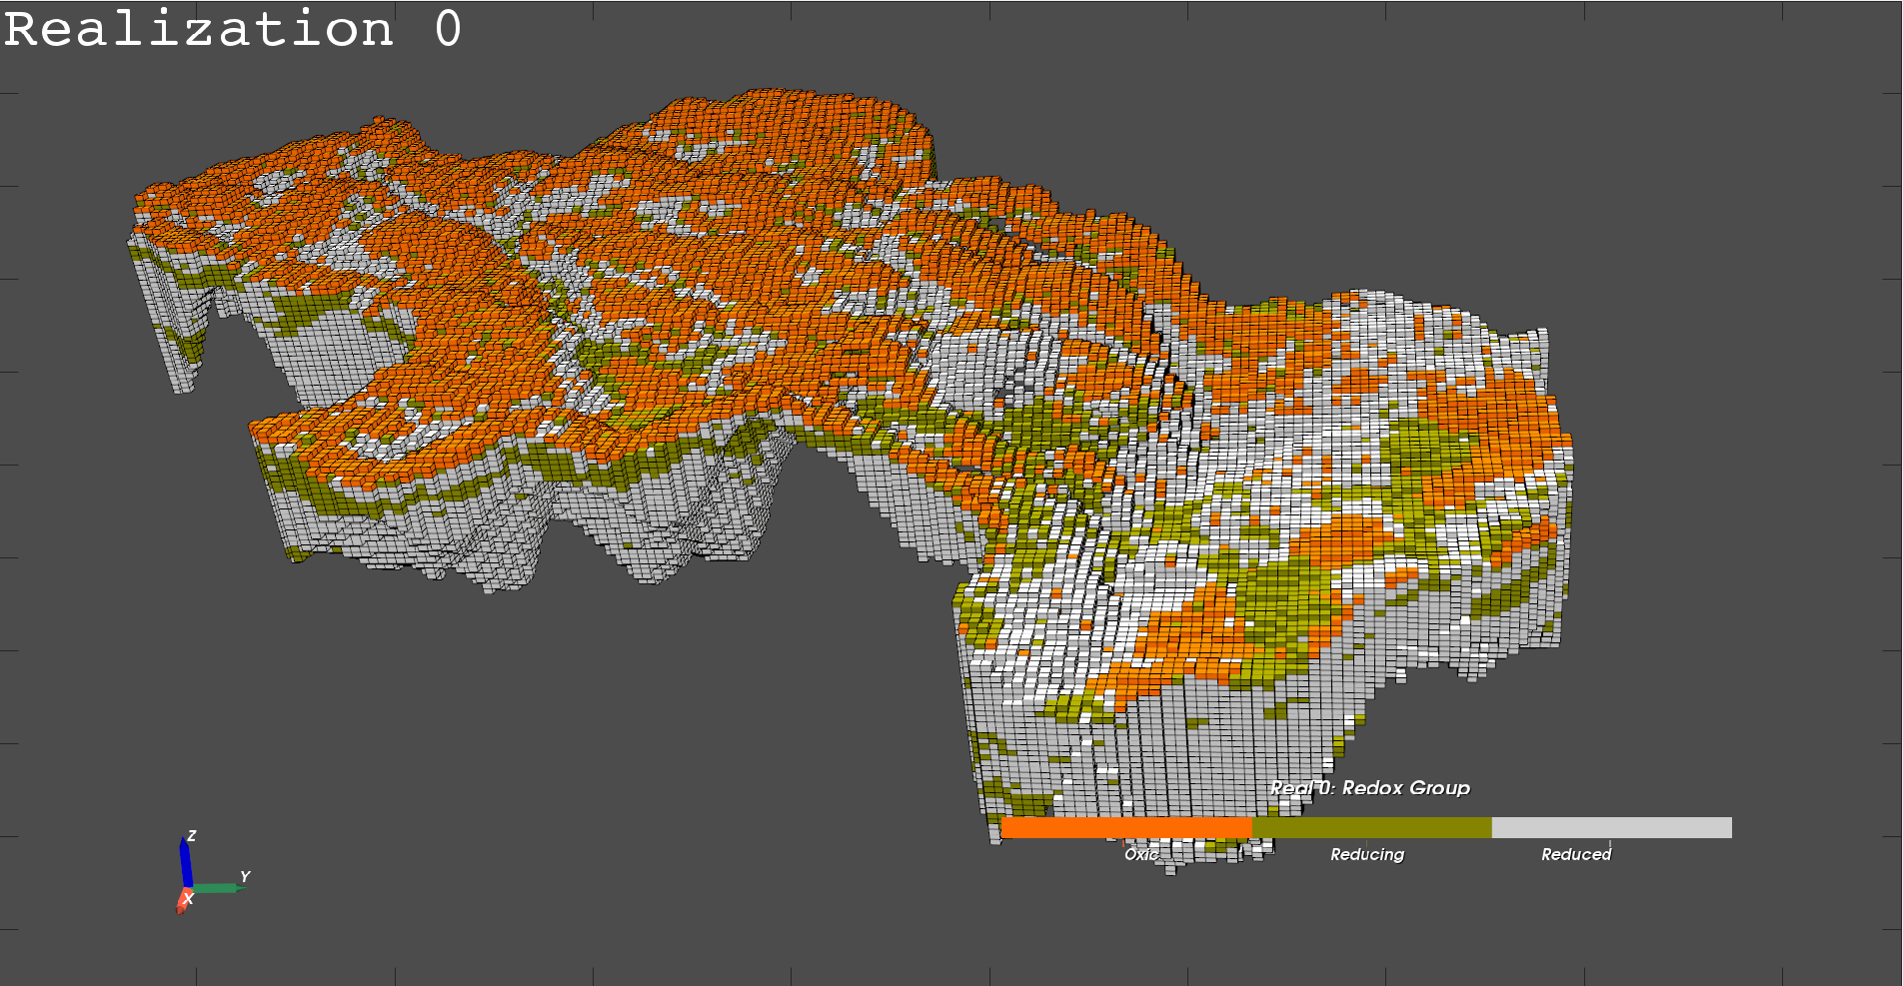
Posterior realizations - Redox

Slide 15
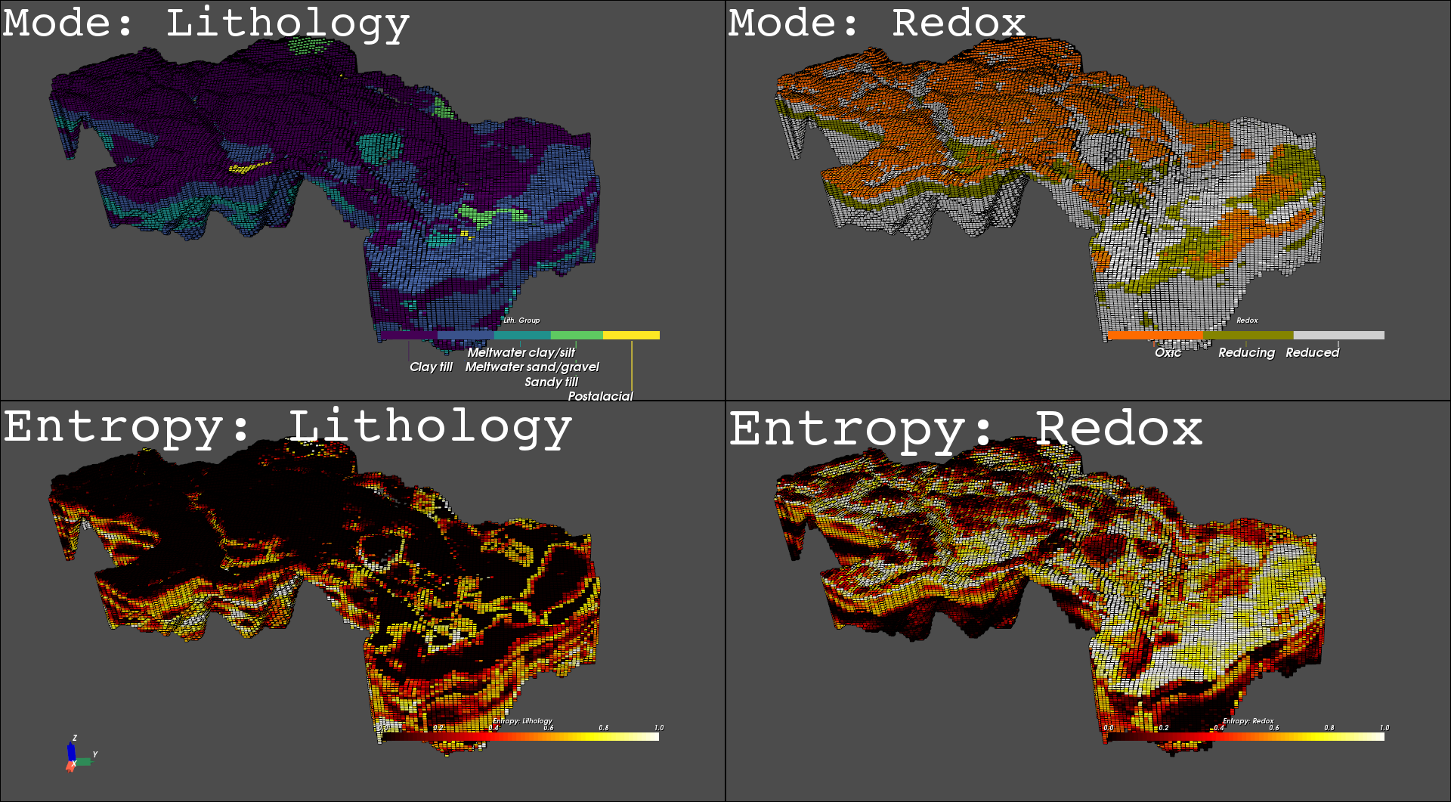
Summary statistics

Slide 16
Why probabilistic?
Multiple possible scenarios
Stochastic subsurface structure input to hydrological models
Quantify uncertainties based on the specific input data.
Ask “questions” directly to the stochastic model.
  What is the probability of finding a given lithology/redox at a certain depth?
  How are redox conditions distributed within each lithological unit?

Slide 17
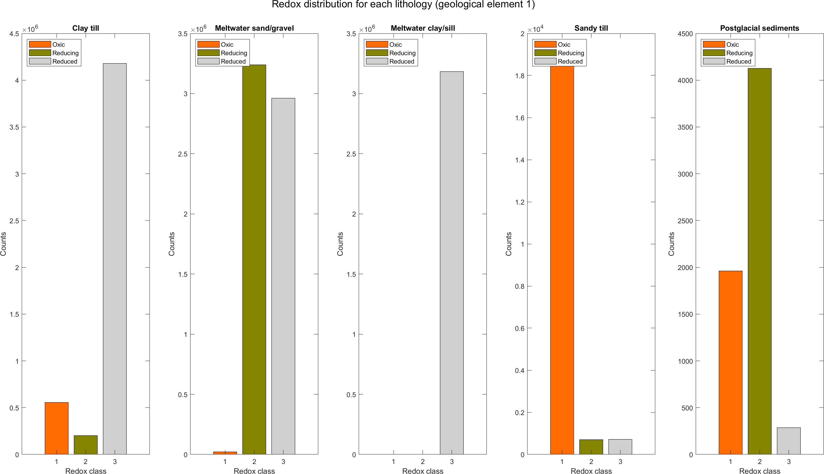
Redox distribution per lithology group: element 1

Slide 18
Thank you for your attention

